Slide 1


DON BOSCO INSTITUTE OF TECHNOLOGY
KUMBALAGODU, BENGALURU
DEPARTMENT OF COMPUTER SCIENCE AND ENGINEERING
Enhancing Seismic Data with Generative Adversarial Network for Affordable MEMs Sensors
Submitted By:
Sparsh Bisen (1DB21CS148)
Surya M (1DB21CS155)
Tejaswini P(1DB21CS158)
U Jeevan Hari (1DB21CS161)
GUIDED BY :
Dr. Venugeetha Y
Professor,
Dept. of CSE,
DBIT

Slide 2
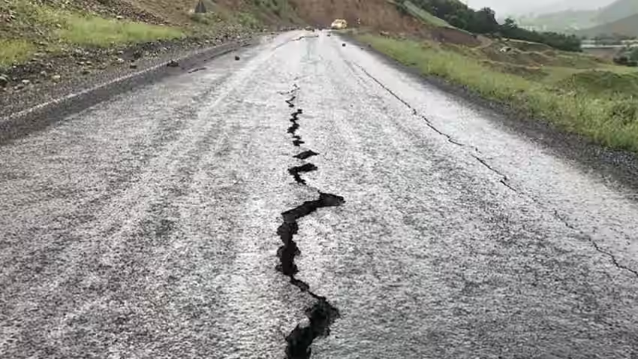
Enhancing Seismic Data with Generative Adversarial Network for Affordable MEMs Sensors

Slide 3
TABLE OF CONTENTS
Sl.No | Contents
 | Abstract
1. | Introduction
2. | Aim & Objectives
3. | Problem Statement
4. | Literature survey
5. | Methodology
6. | Snapshots
7. | Conclusion
8. | Reference

Slide 4
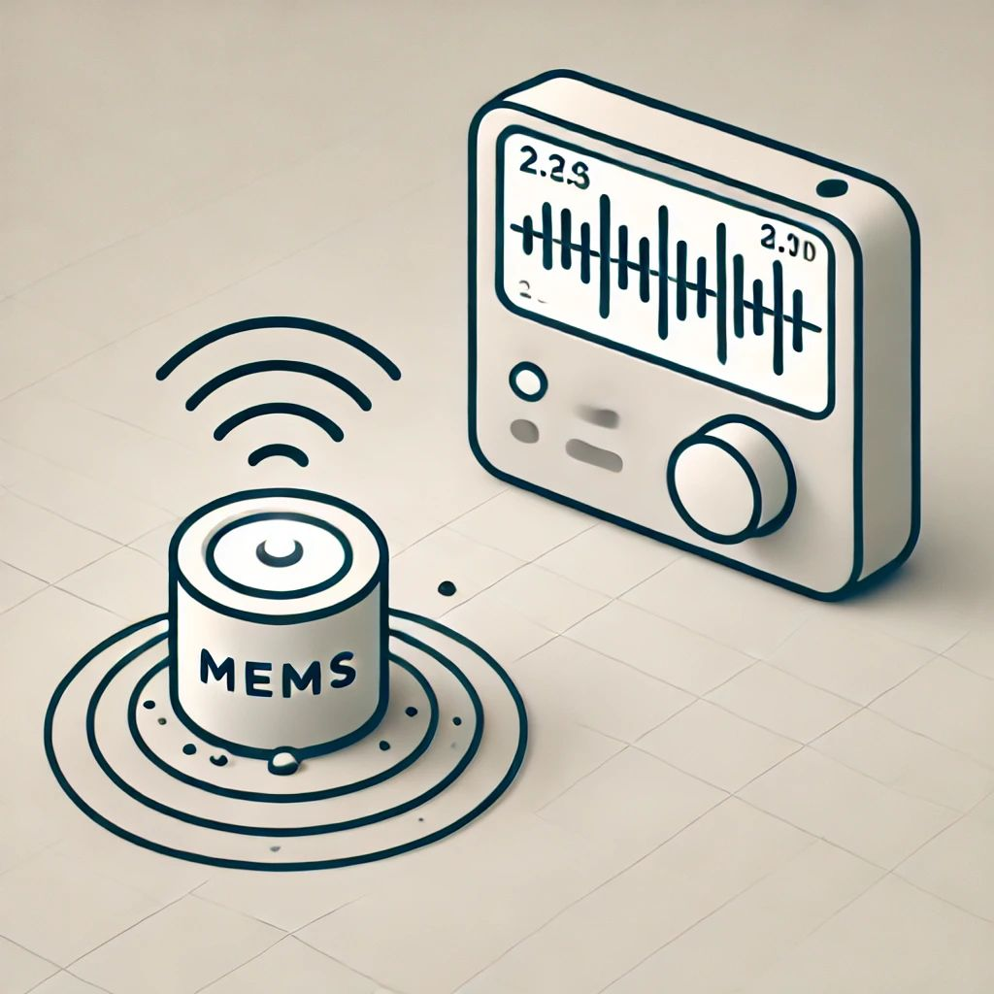
ABSTRACT
• Traditional seismic sensors are accurate but expensive, limiting widespread earthquake monitoring. • MEMS sensors provide a low-cost alternative, but their high noise levels reduce data reliability. • This project introduces a Generative Adversarial Network (GAN)-based approach to enhance seismic data quality. • PCA and ICA are compared with GANs for noise reduction, while LSTM and SVM are analyzed for earthquake prediction. • Results show that GANs outperform noise reduction methods, and LSTM provides better prediction accuracy. • This solution enables affordable, scalable seismic monitoring, improving early warning systems and disaster preparedness

Slide 5
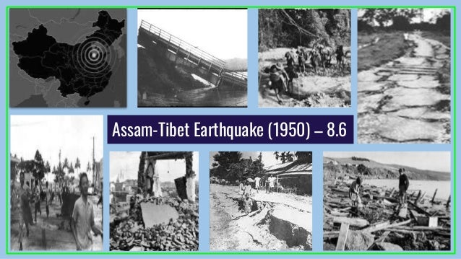
Introduction:
Global Earthquake Management : Earthquakes pose global risks, requiring effective management strategies. Organizations like USGS and global initiatives focus on hazard assessment, early warning systems, and building resilience to minimize damage.
Seismic Activity in Assam, India : One of India’s most earthquake-prone states. Major quakes include the 1897 (M8.1) and 1950 (M8.6) earthquakes, causing widespread destruction. Its proximity to tectonic plate boundaries makes frequent seismic activity a major concern.

Slide 6
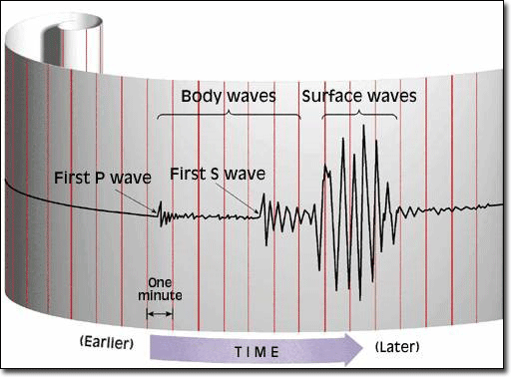
Traditional Earthquake Detection : Conventional methods use seismometers to measure ground motion and detect earthquakes. These systems, while accurate, are expensive and have limited coverage in remote areas.
Present Technology : Advances in MEMS sensors provide a cost-effective alternative but suffer from noise interference. Machine learning models, including CNNs and GANs, are now improving data quality and enhancing earthquake prediction accuracy.

Slide 7
Aim & Objectives:
The aim of this study is to compare the effectiveness of LSTM and SVM models for earthquake prediction and to evaluate the performance of GAN, ICA, and PCA for noise reduction in seismic data. By augmenting the dataset to simulate real-time noise conditions, the study seeks to identify the most accurate and efficient methods for enhancing earthquake detection and data clarity.
Major Objectives of the Project:
To tackle seismic research obstacles, specifically the detection of earthquakes through the utilization of Low-cost MEMS sensors, addressing the issue of noise interference caused by these sensors, which impacts the accuracy of collected data.
• To use GAN,LSTM,PCA,ICA,SVM models on seismic dataset and show the comparison of the models
• To detect early warning signs of earthquake

Slide 8
Problem Statement:
The challenge in seismic activity monitoring arises from the high cost of conventional seismic sensors, which limits their widespread deployment, particularly in resource-constrained regions. In response, low-cost MEMS sensors have been proposed as a more affordable alternative. However, these sensors introduce significant noise in the data, leading to a poor signal-to-noise ratio that complicates the accurate detection of seismic events.
As a result, while MEMS sensors provide a cost-effective solution for large-scale seismic networks, the compromised data quality limits their effectiveness in critical applications such as real-time earthquake monitoring, early warning systems, and seismic hazard assessment.

Slide 9
Literature survey:
[1] Aming Wu et.al., proposed in the paper "Augmenting Seismic Data Using Generative Adversarial Network for Low-Cost MEMS Sensors". They proposed EQGAN, a GAN-based model designed to generate high-quality seismic data from low-cost MEMs sensors. The model demonstrates enhanced stability and performance, achieving up to 81% effectiveness, surpassing other generative models.
[2] Yuanming Li et.al., proposed in the paper "Seismic Data Augmentation Based on Conditional Generative Adversarial Networks". Their review provides a comprehensive overview of recent research employing GANs for the synthetic generation of ground motion signals and seismic data augmentation. It discusses the potential and challenges of Al-based GAN applications in earthquake engineering.

Slide 10
[3] Yuxin Hou et.al., proposed in the paper "A Review on Generative Adversarial Networks: Algorithms, Theory, and Applications". It provides a comprehensive overview of Generative Adversarial Networks (GANs). It discusses the background and theoretical foundations of GANs, as well as various extensions developed to optimize their performance. The paper highlights the wide range of applications of GANs across different domains, including image generation and data augmentation.
[4]Jan Kietzmann et.al., proposed in the paper "Artificial Intelligence and Machine Learning: What Managers Need to Know“. This article provides a managerial perspective on the implications of artificial intelligence (Al) and machine learning (ML) for businesses. It highlights Al's capabilities, such as natural language processing, problem-solving, and knowledge generation, emphasizing its transformative potential across industries.

Slide 11
Methodology:
PCA (Principal Component Analysis):
Missing values in the seismic data are imputed using the mean strategy.
Features are standardized using StandardScaler.
PCA is applied to reduce the dimensionality of the data to 2 principal components.
Explained variance ratio is calculated and plotted to determine the optimal number of principal components.
ICA (Independent Component Analysis):
Similar preprocessing steps are applied, including imputation and scaling.
ICA is used to decompose the data into independent components.
The original and augmented data are plotted along with the ICA-transformed augmented data.
SVM (Support Vector Machine):
Data augmentation techniques like resampling are used.
The SVM classifier is trained on the preprocessed and augmented data.
Model evaluation is performed using accuracy score on the test set.
Predicted labels are plotted against the real and augmented data.

Slide 12
GAN (Generative Adversarial Network):
Missing values are imputed and features are standardized as in previous steps.
GAN architecture is defined, comprising a generator and discriminator.
The generator is trained to generate synthetic seismic data that resembles real data.
The progress of discriminator and generator losses is printed during training.
Original and predicted data are plotted to compare.
LSTM (Long Short-Term Memory):
Data preprocessing involves imputation and scaling as before.
LSTM model is defined and trained on the preprocessed data.
Model evaluation is performed using loss and accuracy metrics.
Original and predicted labels are plotted for comparison.

Slide 13
Proposed Block Diagram:
PCA
SVM
ICA
Comparison
LSTM
GAN

Slide 14
Hardware and Software Specification
Hardware Requirements
Processor : Intel Core 3 and above
RAM: GPU/ TPU
Operating System: Windows 10
Software Requirements
Programming language: Python 8.13.2
IDE: Google Colab

Slide 15
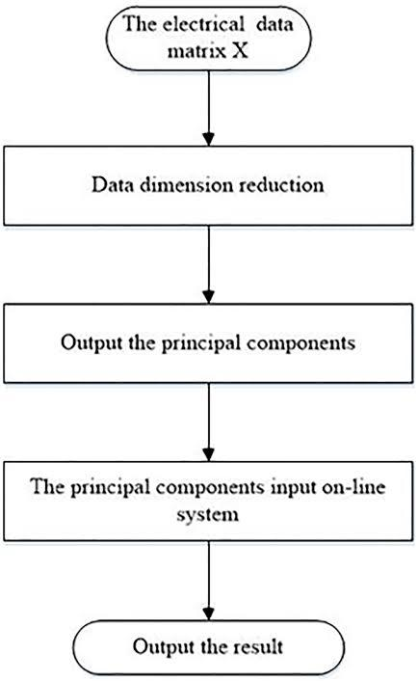
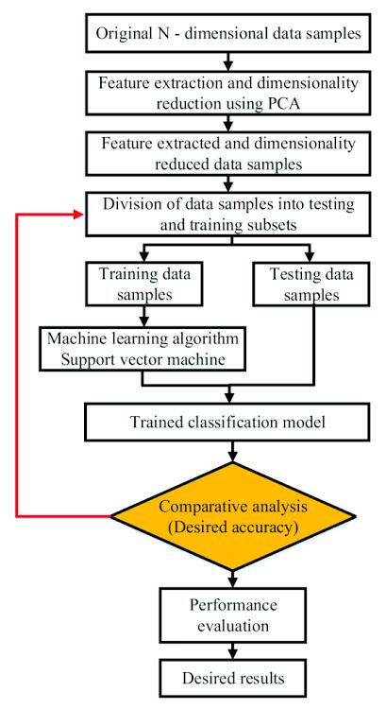
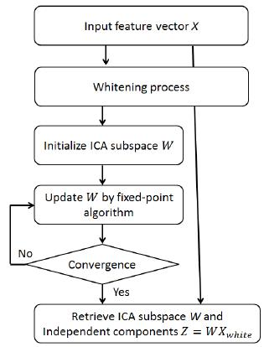
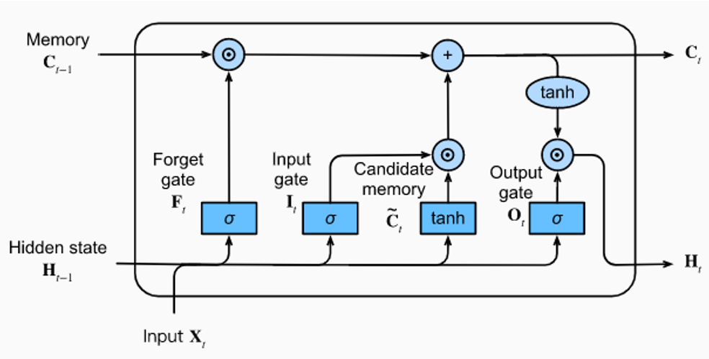
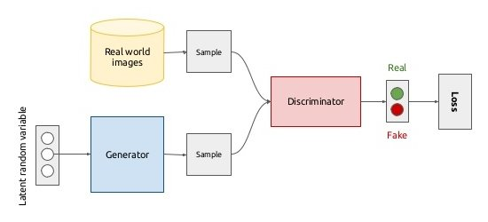
Data Flow Diagram
PCA
SVM
Seismic Data
ICA
LSTM
GAN
COMPARSION
Fig1.1: Implementation Flow Chart

Slide 16
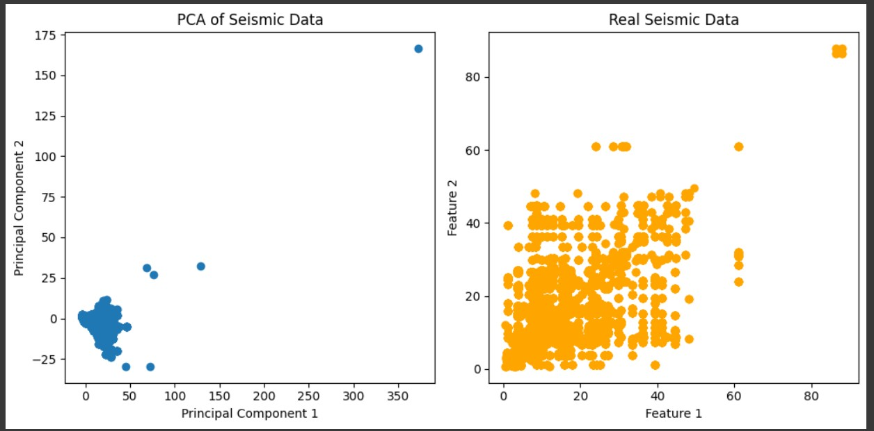
RESULTS:
Fig 1.2 PCA (Principal Component Analysis)

Slide 17
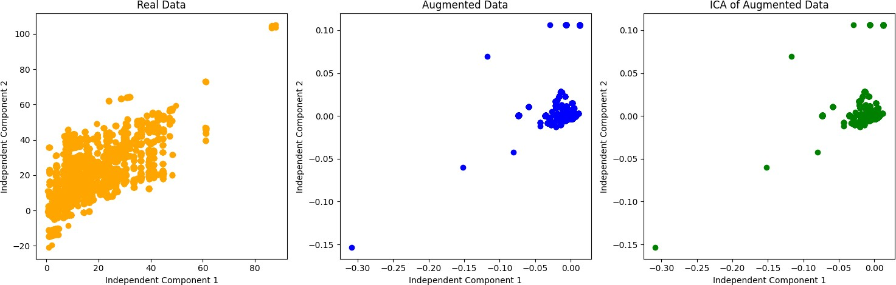
Fig 1.3 -ICA(Independent Component Analysis)

Slide 18
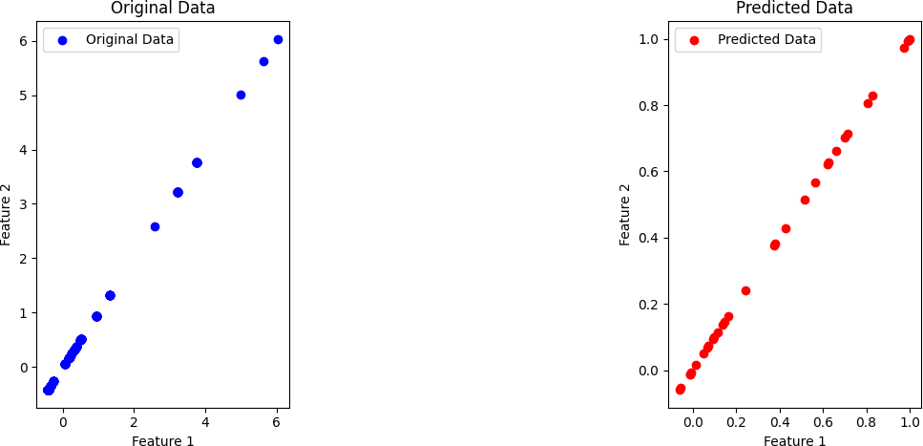
Fig 1.4 GAN (Generative Adversarial Network)

Slide 19
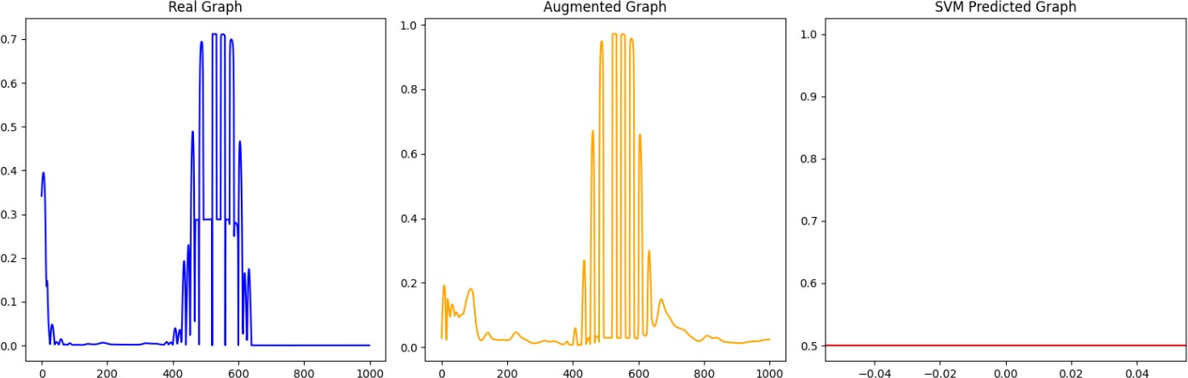
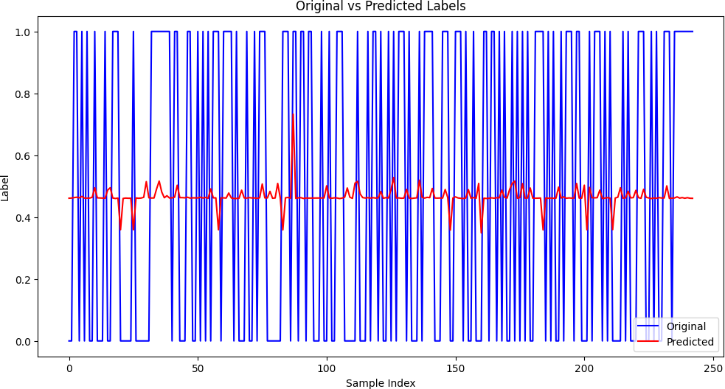
Fig 1.5 SVM (Support Vector Machine)
Fig 1.6 LSTM(Long Short-Term Memory)

Slide 20
This project successfully demonstrated the potential of Generative Adversarial Networks (GANs) in enhancing seismic data captured by low-cost MEMS (Micro-Electromechanical Systems) sensors. MEMS sensors, although economically advantageous, are often limited by lower data quality, including noise and resolution issues, which can hinder accurate seismic analysis .By utilizing GANs for data augmentation, this study effectively addressed these challenges and significantly improved the performance and reliability of seismic data collected from MEMS sensors
CONCLUSION

Slide 21
References:
Aming Wu et.al “Augmenting Seismic Data Using Generative Adversarial Network for Low-Cost MEMS Sensors” IFAC Proc. Volumes, vol. 42, no. 19, pp. 304– 309, 2021.
Yuanming Li et.al, “Seismic Data Augmentation Based on Conditional Generative Adversarial Networks”, Sci. Rep., vol. 9, no. 1, pp. 1–14, Dec. 2020.
Yuxin Hou et.al, “Seismic Data Augmentation Based on Conditional Generative Adversarial Networks”, Sci. Rep., vol. 9, no. 1, pp. 1–14, 2021.
Jan Kietzmann “Artificial Intelligence and Machine Learning: Science, vol. 300, no. 5620, pp. 786–789, 2022.
Tero Karras “StyleGAN: A Style-Based Generator Architecture for Generative Adversarial Networks", Li,’ Geophys. Res. Lett., vol. 45, no. 10, pp. 4773–4779, May 2018.
Lian gonog “Generative Adversarial Networks”. IEEE Internet Things J., vol. 6, no. 2, pp. 3024–3030, Apr. 2020.
D. Ciuonzo, S. H. Javadi, A. Mohammadi, and P. S. Rossi, “Bandwidth constrained decentralized detection of an unknown vector signal via multi sensor fusion”, IEEE Trans. Signal Inf. Process. Netw., vol. 6, pp. 744 758,2020.
M. Faulkner, M. Olson, R. Chandy, J. Krause, K. M. Chandy, and A. Krause, “The next big one: Detecting earthquakes and other rare events from community-based sensors”,in Proc. 10th ACM/IEEE Int. Conf. Inf.Process. Sensor Netw., Apr. 2021, pp. 13–24.
D. Li, R. Landry, and P. Lavoie, “Low-cost MEMS sensor-based attitude determination system by integration of magnetometers and GPS: A real data test and performance evaluation”, in Proc. IEEE/ION Position, Loca tion Navigat.Symp., May 2020, pp. 1190–1198.
O. M. Saad, G. Huang, Y. Chen, A. Savvaidis, S. Fomel, N. Pham, and Y. Chen, “SCALODEEP: A highly generalized deep learning framework for real time earthquake detection”, J. Geophys. Res., Solid Earth, vol. 126, no. 4, Apr. 2021, Art. no. e2020JB021473.

Slide 22
THANK YOU

